Slide 1
Keylogger Detection and Prevention System
CAPSTONE PROJECT
Presented By:
Parthiban.G-Kings Engineering College-
210821205069-IT Department

Slide 2
OUTLINE
Problem Statement
Proposed System/Solution
System Development Approach
Algorithm & Deployment
Result (Output Image)
Conclusion
Future Scope
References

Slide 3
Problem Statement
Develop a robust keylogger application named "Keylogger for Remote Monitoring and Reporting" that can capture user keystrokes and remotely transmit the logged data to a central server for analysis and monitoring. The keylogger should operate discreetly in the background, continuously monitoring and recording all keyboard inputs. Furthermore, the application should be capable of periodically uploading the captured keystrokes to a secure remote server, allowing for centralized monitoring and reporting of user activities. Ensure that the keylogging process is secure, the data transmission is encrypted, and the user interface is intuitive for seamless operation. The primary goal is to create a comprehensive remote monitoring solution that provides organizations with valuable insights into employee computer usage and potential security breaches.

Slide 4
Proposed Solution
Background Keylogging: The keylogger will run silently in the background, capturing all user keystrokes without interrupting the workflow.
Keystroke Capture: Utilizing the pynput library, the application will monitor keyboard input and record each keystroke with associated metadata (timestamp, event type, etc.).
Secure Data Storage: The captured keystrokes will be stored locally in an encrypted database or file, ensuring the confidentiality of the recorded information.
Remote Reporting: At predefined intervals or upon triggering a specific event, the keylogger will securely transmit the logged data to a central server over an encrypted connection.
Server-side Analysis: The remote server will receive the keylogging data, providing administrators with comprehensive reports on user activities, potential security risks, and productivity insights.
User Interface: The application will feature a streamlined GUI that allows users to configure settings, view connection status, and access reporting features.
Security Measures Encryption: The keylogging data and communication with the remote server will be protected using strong encryption algorithms.
Access Control: Implement authentication and authorization mechanisms to ensure only authorized personnel can access the keylogger settings and reports.
Compliance and Regulations: The keylogger solution will be designed to comply with relevant data privacy regulations, ensuring ethical and lawful deployment within the organization.
Comprehensive Reporting: The remote server will generate detailed reports on user activities, including time-stamped keystroke logs, application usage patterns, and potential security incidents.

Slide 5
System Approach
The keylogger application will be developed using Python, leveraging its extensive library support and cross- platform compatibility. The pynput library will be utilized for keyboard event monitoring and data capture. For secure data storage and transmission, the application will integrate encryption and database management functionalities. The Tkinter library will be employed for creating a user-friendly graphical interface, enabling configuration and monitoring capabilities.

Slide 6
Algorithm & Deployment
Initialization:
Initialize essential variables and data structures for keystroke logging and remote reporting.
Set up a secure database or file storage system for local data management.
Listener Setup:
Establish a key press listener using the pynput library to capture keyboard events in real-time.
Implement callback functions to handle key press and release events, logging the associated data (timestamp, key, event type).
Secure Data Storage:
Encrypt the logged keystroke data using strong cryptographic algorithms (e.g., AES, RSA).
Store the encrypted data in the local database or file system for temporary storage.
Remote Reporting:
At predefined intervals (e.g., every 60 minutes) or upon specific triggering events (e.g., system shutdown, user logout), initiate a secure connection to the remote server.
Transmit the encrypted keylogging data to the remote server over an SSL/TLS-protected channel.
Receive acknowledgment from the server and update the local data storage accordingly.
User Interface:
Develop a Tkinter-based graphical user interface (GUI) to allow users to configure settings, view connection status, and access reporting features.
Provide clear feedback on the keylogger's operation, data transmission status, and any errors or warnings.

Slide 7
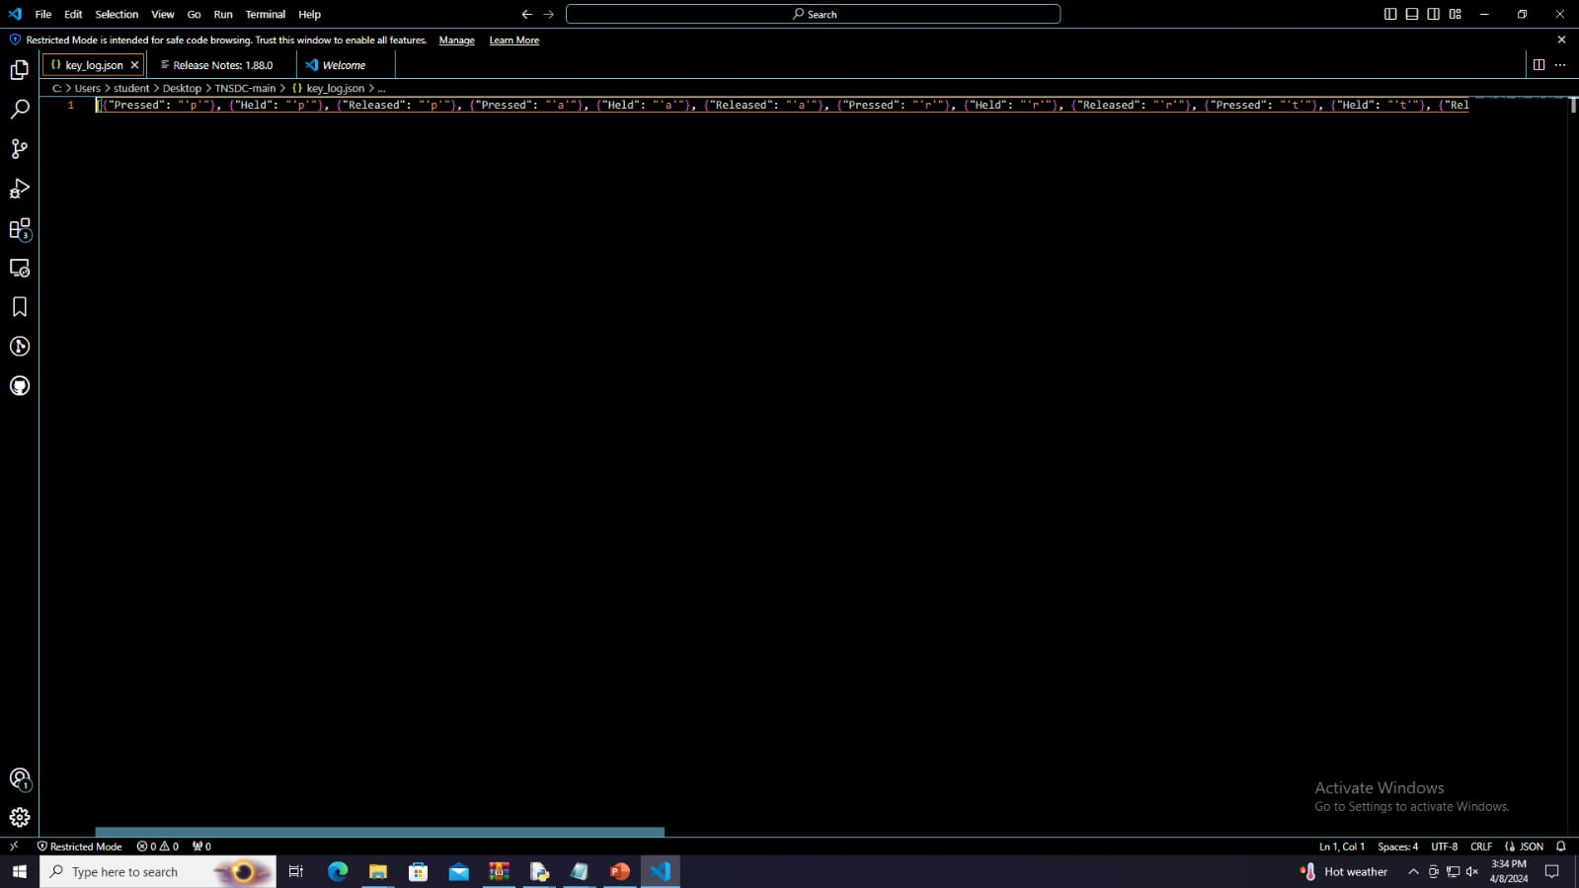
Result

Slide 8

Result

Slide 9
Conclusion
The "Keylogger for Remote Monitoring and Reporting" application has been developed as a comprehensive solution for organizations to monitor and analyze user computer activities remotely. By capturing keystrokes discreetly in the background and securely transmitting the data to a central server, the application provides valuable insights into employee productivity, potential security breaches, and compliance with organizational policies. The robust security measures, including data encryption and access control, ensure the confidentiality and integrity of the collected information. The user-friendly interface and compliance with relevant data privacy regulations further enhance the application's practicality and acceptability within the targeted organizational environment.

Slide 10
Future scope
The future scope of this keylogger project includes several potential enhancements:
Integration with machine learning algorithms for advanced behavioral analysis and anomaly detection
Expansion of reporting capabilities to include detailed session logs, application usage patterns, and productivity metrics
Development of mobile and cloud-based versions to enable cross-device monitoring and remote accessibility
Incorporation of real-time alerting mechanisms to notify administrators of suspicious activities or security incidents
Seamless integration with existing enterprise security and monitoring systems for comprehensive risk management As organizations continue to face evolving cybersecurity challenges, the need for robust and adaptable remote monitoring solutions will only increase. Ensuring the ethical and compliant deployment of such tools while continuously improving their capabilities will be crucial for maintaining organizational security and productivity.

Slide 11
References
Cybersecurity and Data Privacy Regulations:
General Data Protection Regulation (GDPR)
Health Insurance Portability and Accountability Act (HIPAA)
National Institute of Standards and Technology (NIST) Cybersecurity Framework
Python Libraries:
pynput Library Documentation: https://pynput.readthedocs.io/en/latest/
Tkinter Library Documentation: https://docs.python.org/3/library/tkinter.html
Academic Papers and Industry Reports:
"A Survey on Keylogging in Cybersecurity: Threats, Detection, and Countermeasures" by Ahmed Salem, et al. (IEEE Access, 2019)
Technical Blogs and Tutorials:
"Building a Keylogger in Python" by Brandon Skerritt: https://www.thepythoncode.com/article/write-a-keylogger-python
"Creating a GUI Application with Tkinter" by Real Python: https://realpython.com/python-gui-tkinter/

Slide 12
THANK YOU

